Slide 1
Effective Data & Time Series Analysis with Deedle
Howard Mansell
@hmansell
Tomas Petricek
@tomaspetricek

Slide 2
software stacks trainings teaching F# user groups snippets mac and linux cross-platform tutorials
F# Software Foundation
F# community open-source MonoDevelop
http://www.fsharp.org
contributions research support consultancy mailing list

Slide 3
data acquisition statistics data cleaning machine learning data transformation data analysis
Data Science Working Group
interop visualization presentation
fsharp.org/data-science
time-series analysis data aggregation

Slide 4
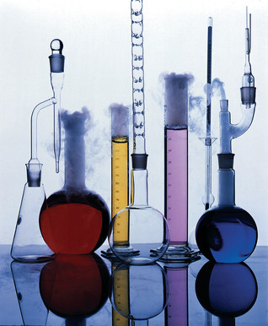
http://www.fslab.org

Slide 5

F# RProvider
http://bluemountaincapital.github.io/FSharpRProvider/

Slide 6

Deedle
http://bluemountaincapital.github.io/Deedle/

Slide 7
Deedle is for…
(Exploratory) Data Analysis
Time-Series Analysis
Data Processing / Transformation
Data Cleaning
Statistics and Visualization, via other packages

Slide 8
Deedle is…
Our third iteration
Easy-to-use from C# and F#
Well documented
Open Source
Ready for you to contribute

Slide 9
Deedle Concepts
Series
Key->Value mapping
Key is often date/time
Immutable
Supports missing values
LINQ-friendly

Slide 10
Deedle Concepts
Frame
(RowKey, ColKey)->Value
RowKey is often date/time
ColKey is often string
Heterogeneous Values
Column-wise mutable
Data alignment
Hierarchical indexing

Slide 11
Deedle Demos

Slide 12
DEMO
Understanding Titanic disaster

Slide 13

Understanding titanic disaster
Deedle data frame
Exploring data
Hierarchical indexing
F# Charting library
Simple visualization
F# interactive support
Composable charts

Slide 14
DEMO
Working with stock prices

Slide 15

Working with stock prices
F# Data providers
Data exploration
CSV, XML, JSON
Other interesting data
Deedle time series
Standard statistics
Rows/columns of a frame

Slide 16
DEMO
Analyzing US debt

Slide 17
Analyzing US debt
Deedle data frame
Data exploration
Alignment & aggregation
R type provider
Deedle frame interop
Time series interop (zoo)
Professional packages
(ggplot2, etc.)

Slide 18
Deedle Needs You
Contribute
Try it out
Ask questions
Report bugs
Fix bugs
Add features
Integrate with other packages

Slide 19
FSLab Futures
Visualization
Better Linux/OS X support
IDE integration
Excel integration
Data sources

